Slide 1
Lecture 5
ITEC618
Text I/O
Programming Concepts
Lecturer: Dr. Farshid Keivanian

Slide 2
The File Class
The File class is intended to provide an abstraction that deals with most of the machine-dependent complexities of files and path names in a machine-independent fashion.
The filename is a string.
The File class is a wrapper class for the file name and its directory path.

Slide 3
The File Class
Introduction:
The File class in Java is an essential tool for managing file and directory pathnames in a machine-independent manner. It abstracts the complexities associated with handling different file systems, allowing you to focus on file manipulation tasks without worrying about the underlying system details.

Slide 4
The File Class
Key Terms:
Abstraction: Simplifies the interaction with file systems by hiding the underlying complexities.
Wrapper Class: Encapsulates the file name and its directory path, making it easier to work with file paths as objects.

Slide 5
The File Class
Practical Scenario:
Imagine you're working at Google as a software engineer, and you need to create a Java application that processes log files stored in different directories. The application needs to list all files in a specific directory, check their properties (such as whether they are readable or hidden), and possibly rename or delete them based on certain conditions.
Using the File class, you can easily manage these tasks without worrying about the differences in file systems between your development machine and the production servers.

Slide 6
The File Class
Class Discussion Question:
How would you use the File class to check if a file is writable before attempting to save changes to it? Why is it important to perform such a check in real-world applications?
Responses:
You might use the canWrite() method of the File class to verify if the file can be written to.
This check is important to prevent runtime errors and to ensure data integrity, especially when dealing with critical files like configuration files or logs.

Slide 7
The File Class
Multiple-Choice Question:
Which of the following best describes the purpose of the File class in Java?
To read and write file content directly.
To abstract machine-dependent file path complexities and handle file operations.
To manage network connections in a Java application.
To create graphical user interfaces.

Slide 8
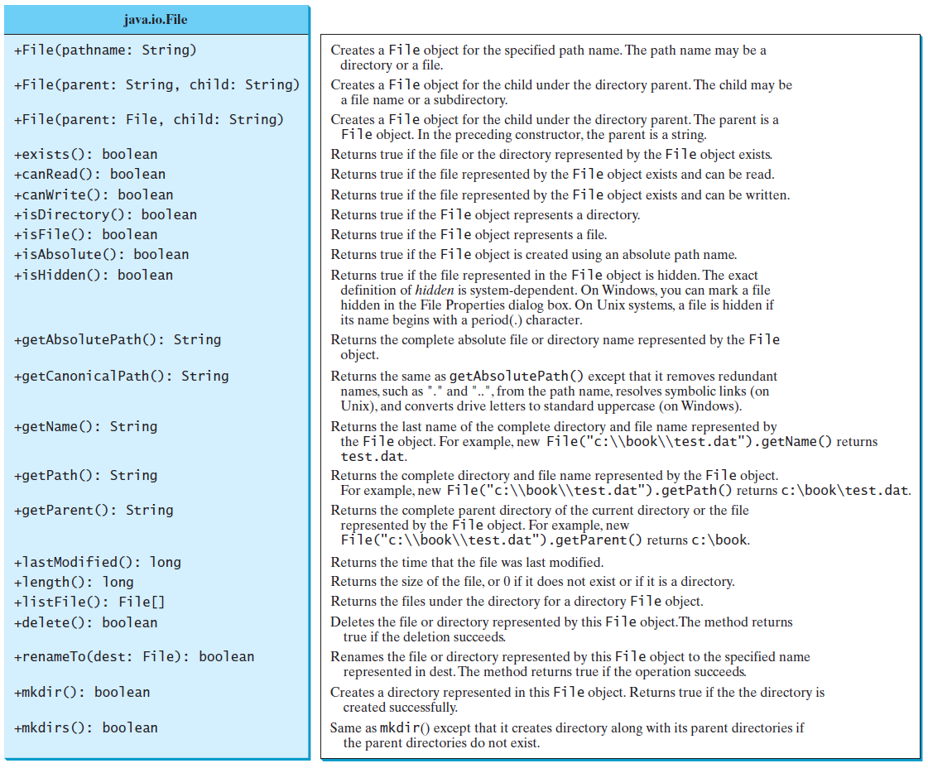
Obtaining file properties and manipulating file

Slide 9
Obtaining File Properties and Manipulating Files
Introduction:
The File class provides a wide range of methods to obtain file properties and perform file manipulations such as renaming, deleting, and creating directories. Understanding these methods is crucial for effective file management in any Java application.
Key Terms:
File Properties: Attributes of a file such as its size, last modified date, and read/write permissions.
File Manipulation: Actions performed on files, such as renaming or deleting.

Slide 10
Obtaining File Properties and Manipulating Files
Practical Scenario:
You are tasked with developing a file management system for Netflix that needs to handle user-uploaded videos. The system must check the file properties to ensure they meet certain criteria (e.g., file size and format), rename files to a standard format, and organize them into appropriate directories. Using the methods provided by the File class, you can implement these functionalities efficiently.

Slide 11
Obtaining File Properties and Manipulating Files
Class Discussion Question:
What method would you use to obtain the absolute path of a file, and why might this be important when dealing with file storage on different operating systems?
Responses:
You would use the getAbsolutePath() method to obtain the full path to a file, which is important for ensuring that the file can be correctly accessed and manipulated regardless of the operating system.

Slide 12
Obtaining File Properties and Manipulating Files
Multiple-Choice Question:
Which of the following methods is used to delete a file in Java using the File class?
delete()
remove()
erase()
destroy()

Slide 13
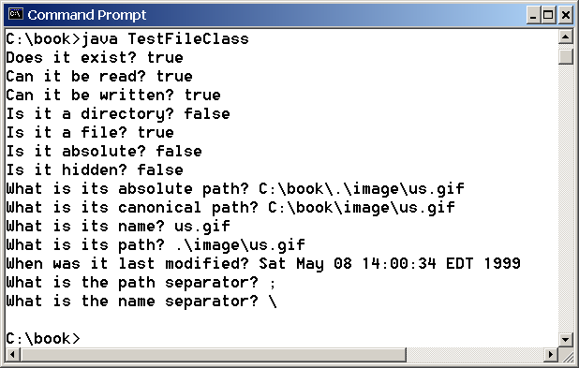
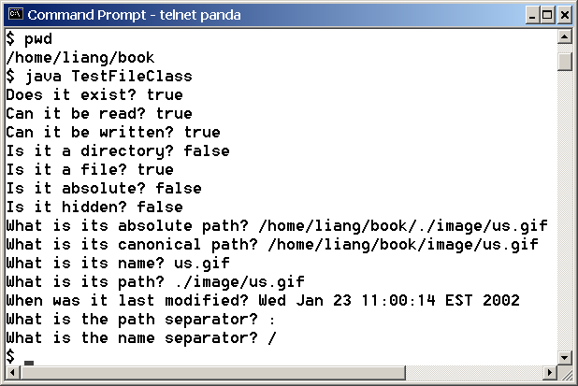
Problem: Explore File Properties
Objective: Write a program that demonstrates how to create files in a platform-independent way and use the methods in the File class to obtain their properties. The following figures show a sample run of the program on Windows and on Unix.
TestFileClass

Slide 14
Problem: Explore File Properties
Introduction:
In Java, the File class is not just about creating or deleting files, but also about exploring various properties of files in a platform-independent way. Understanding these properties is crucial when working with files across different operating systems. The objective of this problem is to write a program that demonstrates how to create and manipulate files, and then use the methods provided by the File class to obtain their properties. This is particularly useful in scenarios where your program needs to adapt to different environments, such as Windows and Unix.

Slide 15
Problem: Explore File Properties
Key Terms:
Platform-Independent: The ability of a program to run on various operating systems without modification.
File Properties: Attributes such as existence, readability, writability, directory status, and more.

Slide 16
Problem: Explore File Properties
Practical Scenario:
Imagine you're working at Dropbox, a company that provides cloud storage services to millions of users worldwide. As a software engineer, you're tasked with developing a feature that scans and reports on the properties of user-uploaded files to ensure they meet certain criteria, like being readable and not hidden. This feature must work seamlessly across multiple operating systems since Dropbox users might be on Windows, Mac, or Linux. By utilizing the File class in Java, you can create a robust tool that checks these file properties, ensuring consistency and reliability in your service.
Class Discussion Question:
How would you modify the TestFileClass program to not only check if a file exists and its properties but also to create the file if it does not exist? Why might this be necessary in a real-world application?

Slide 17
Problem: Explore File Properties
Responses:
You might use the createNewFile() method of the File class to create a file if it does not exist.
This could be necessary in real-world applications to ensure that necessary files are always available for operation, such as configuration files or logs.

Slide 18
Problem: Explore File Properties
Multiple-Choice Question:
Which of the following statements about the File class in Java is correct?
The File class can only handle text files.
The File class methods are platform-dependent.
The File class provides methods to check various file properties like existence and readability.
The File class automatically opens and reads file contents.

Slide 19
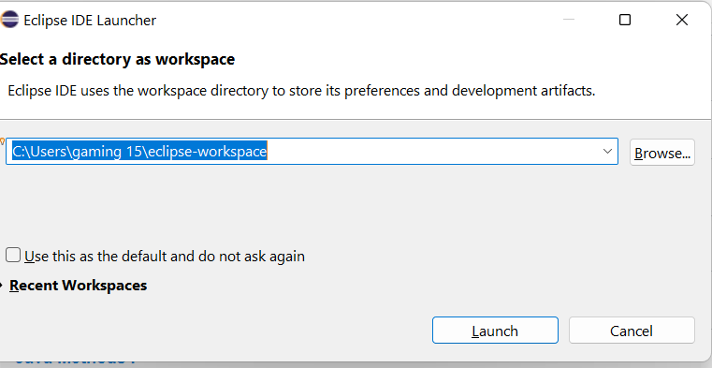
Problem: Explore File Properties

Slide 20
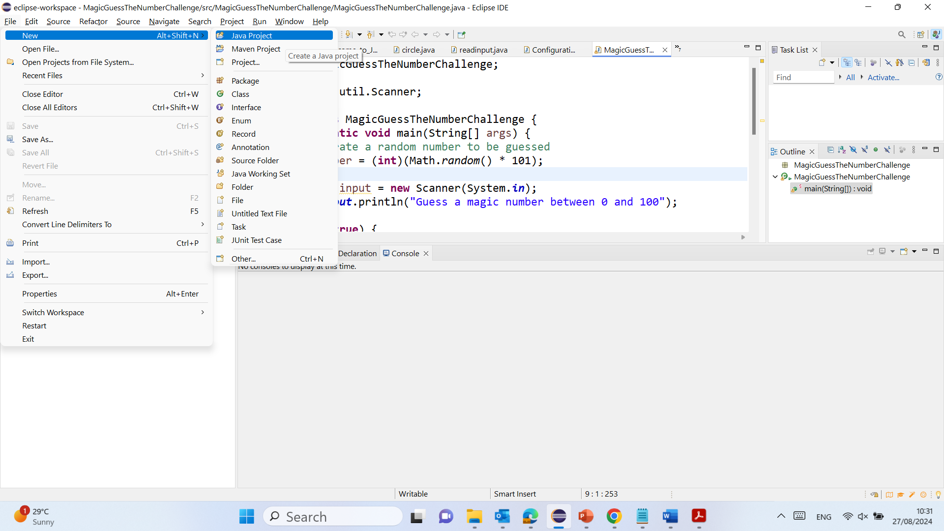
Problem: Explore File Properties

Slide 21
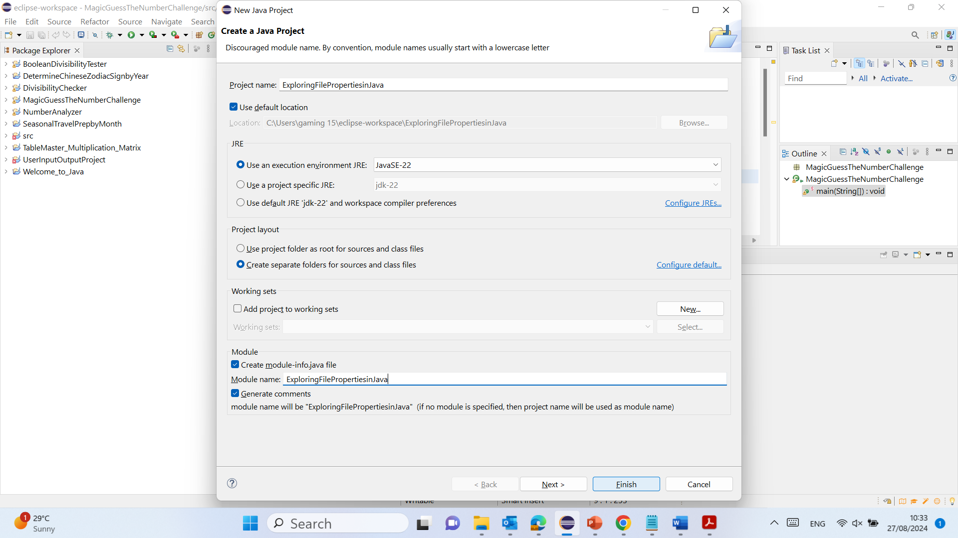
Problem: Explore File Properties

Slide 22
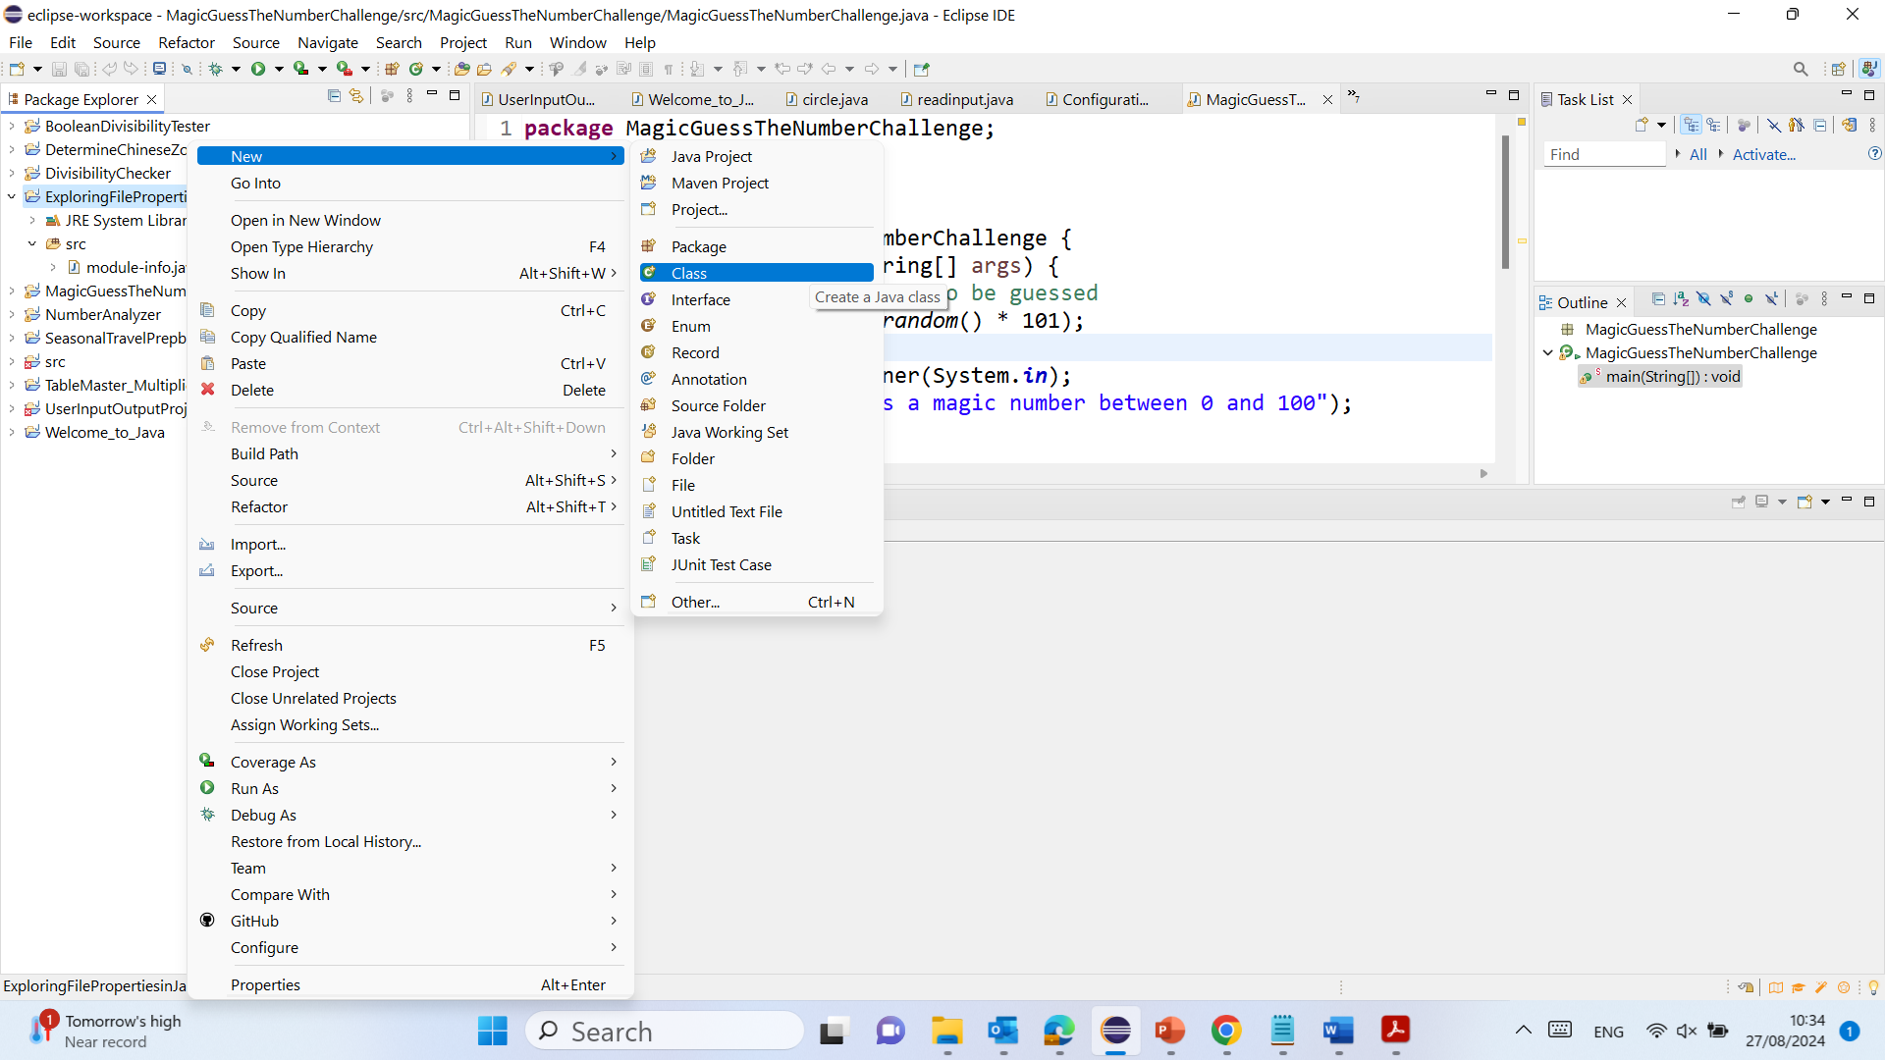
Problem: Explore File Properties

Slide 23
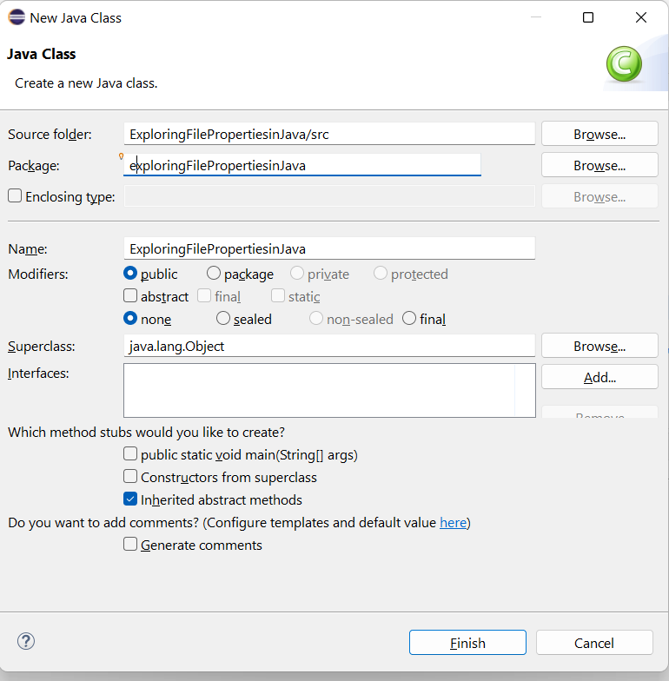
Problem: Explore File Properties

Slide 24
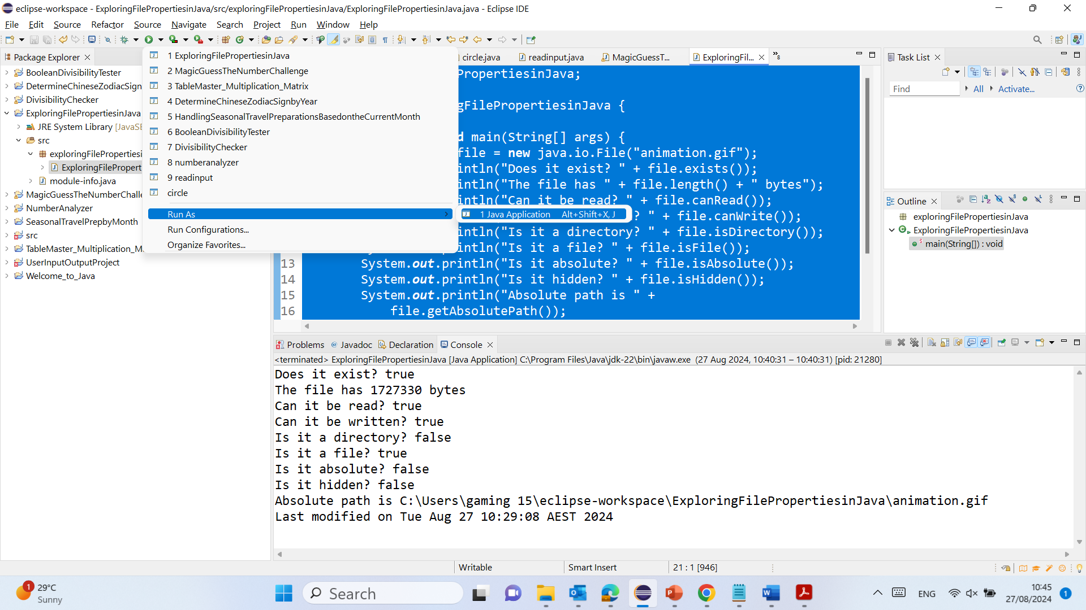
Problem: Explore File Properties

Slide 25
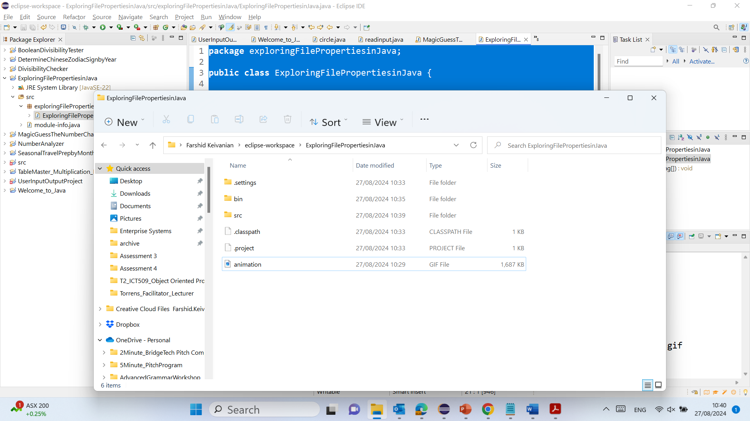
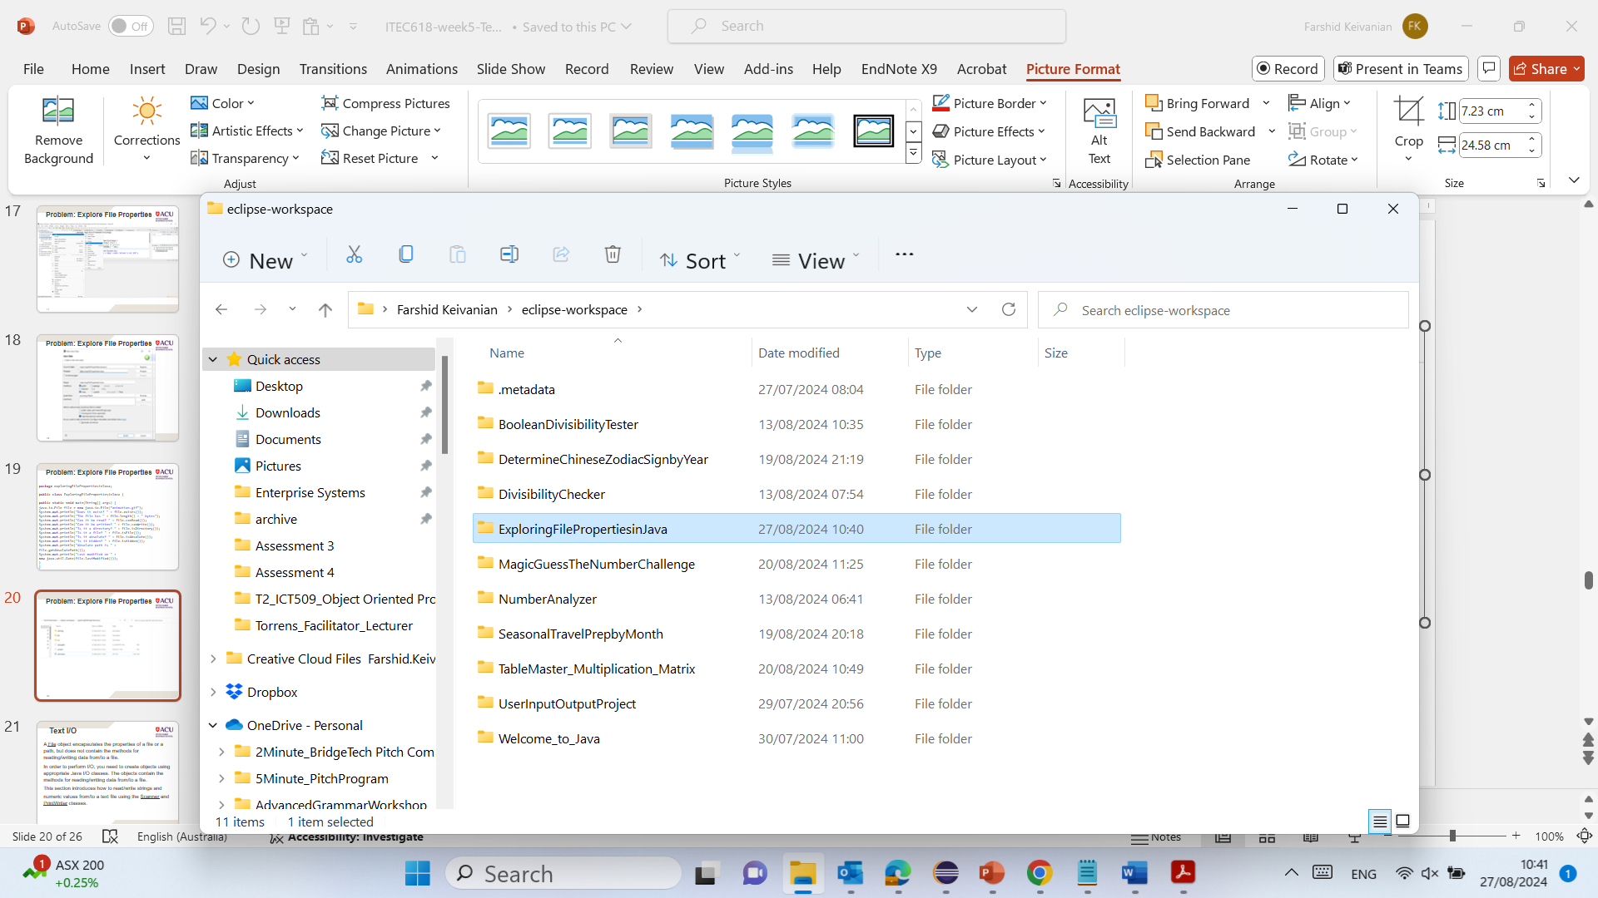
Problem: Explore File Properties

Slide 26
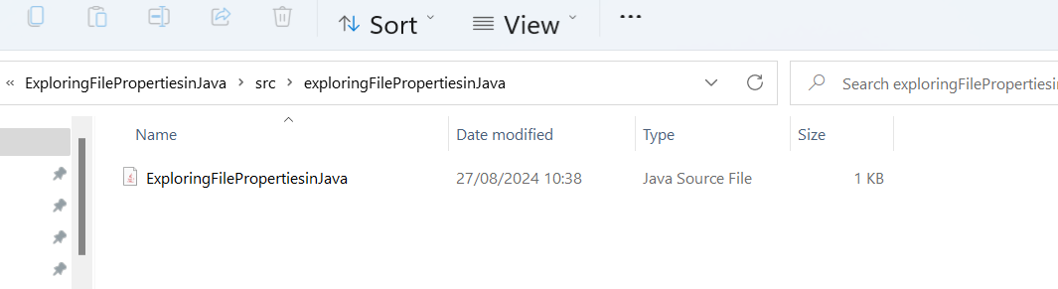
Problem: Explore File Properties
C:\Users\....\eclipse-workspace\ExploringFilePropertiesinJava\src\exploringFilePropertiesinJava

Slide 27
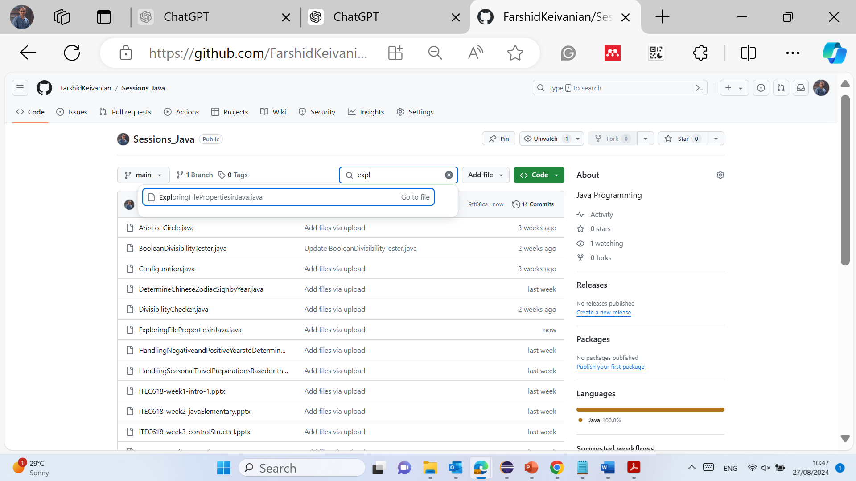
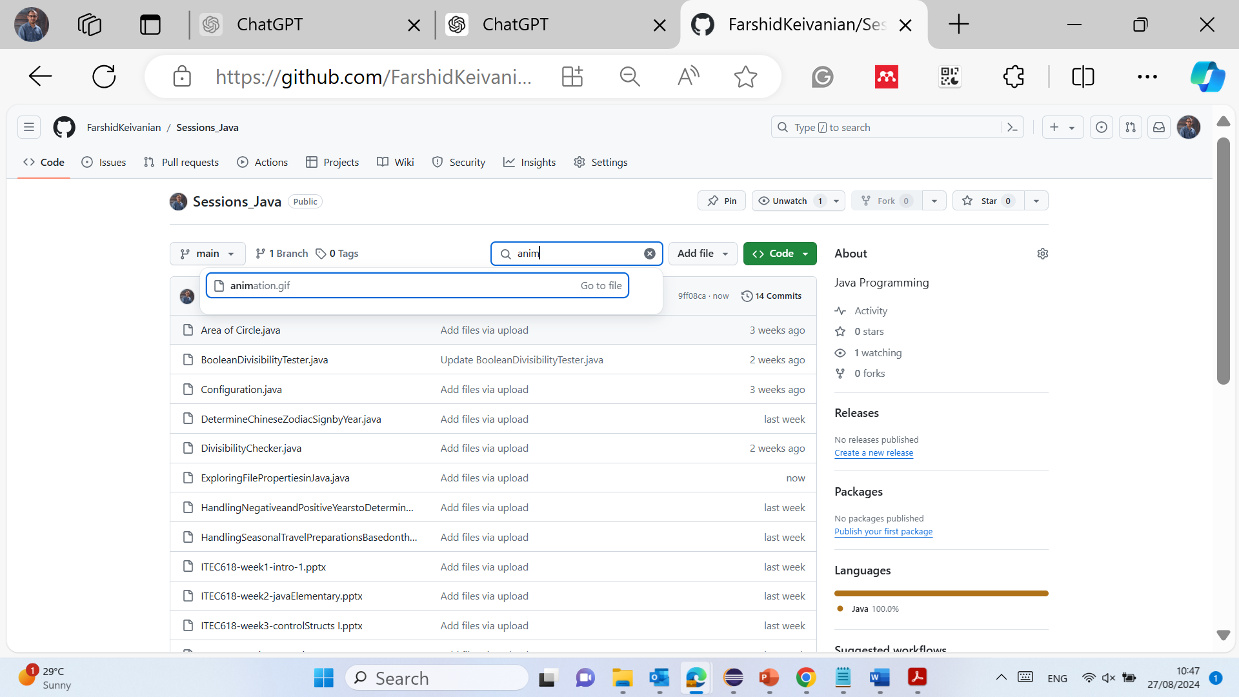
Problem: Explore File Properties

Slide 28
Problem: Explore File Properties
package exploringFilePropertiesinJava;
public class ExploringFilePropertiesinJava {
public static void main(String[] args) {
java.io.File file = new java.io.File(“animation.gif");
System.out.println("Does it exist? " + file.exists());
System.out.println("The file has " + file.length() + " bytes");
System.out.println("Can it be read? " + file.canRead());
System.out.println("Can it be written? " + file.canWrite());
System.out.println("Is it a directory? " + file.isDirectory());
System.out.println("Is it a file? " + file.isFile());
System.out.println("Is it absolute? " + file.isAbsolute());
System.out.println("Is it hidden? " + file.isHidden());
System.out.println("Absolute path is " +
file.getAbsolutePath());
System.out.println("Last modified on " +
new java.util.Date(file.lastModified()));
}
}

Slide 29
Problem: Explore File Properties
package exploringFilePropertiesinJava;
1. package exploringFilePropertiesinJava;
Explanation: This line declares the package in which this class resides. A package is a namespace that organizes a set of related classes and interfaces. In this case, exploringFilePropertiesinJava is the package name, which helps organize the code and avoid class name conflicts in larger projects.

Slide 30
Problem: Explore File Properties
public class ExploringFilePropertiesinJava {
2. public class ExploringFilePropertiesinJava {
Explanation: This line declares a public class named ExploringFilePropertiesinJava. The class is the blueprint from which objects are created. In Java, every application begins with a class definition. The public keyword means that this class is accessible from any other class.

Slide 31
Problem: Explore File Properties
public static void main(String[] args) {
3. public static void main(String[] args) {
Explanation: This line defines the main method, which is the entry point of any Java application. The main method is where the program starts execution.
public: The method is accessible from anywhere.
static: This means the method belongs to the class rather than an instance of the class.
void: The method does not return any value.
String[] args: This is an array of strings that can store command-line arguments passed to the program when it is executed.

Slide 32
Problem: Explore File Properties
java.io.File file = new va.io.File("animation.gif");
4. java.io.File file = new java.io.File("animation.gif");
Explanation: This line creates a new File object, which represents the file located at image/us.gif. The java.io.File class is used to perform operations on files and directories. In this case, the file path provided is relative, meaning it is relative to the current working directory of the application.

Slide 33
Problem: Explore File Properties
System.out.println("Does it exist? " + file.exists());
5. System.out.println("Does it exist? " + file.exists());
Explanation: This line checks if the file exists using the exists() method of the File class. It prints the result (true or false) to the console. System.out.println is used to output text to the console.

Slide 34
Problem: Explore File Properties
System.out.println("The file has " + file.length() + " bytes");
6. System.out.println("The file has " + file.length() + " bytes");
Explanation: This line prints the size of the file in bytes using the length() method of the File class. If the file does not exist, this method will return 0.

Slide 35
Problem: Explore File Properties
System.out.println("Can it be read? " + file.canRead());
7. System.out.println("Can it be read? " + file.canRead());
Explanation: This line checks if the file is readable using the canRead() method of the File class. It prints true if the file can be read, otherwise false

Slide 36
Problem: Explore File Properties
System.out.println("Can it be written? " + file.canWrite());
8. System.out.println("Can it be written? " + file.canWrite());
Explanation: This line checks if the file is writable using the canWrite() method of the File class. It prints true if the file can be written to, otherwise false.

Slide 37
Problem: Explore File Properties
System.out.println("Is it a directory? " + file.isDirectory());
9. System.out.println("Is it a directory? " + file.isDirectory());
Explanation: This line checks if the path represents a directory using the isDirectory() method of the File class. It prints true if it is a directory, otherwise false.

Slide 38
Problem: Explore File Properties
System.out.println("Is it a file? " + file.isFile());
10. System.out.println("Is it a file? " + file.isFile());
Explanation: This line checks if the path represents a file (as opposed to a directory) using the isFile() method of the File class. It prints true if it is a file, otherwise false.

Slide 39
Problem: Explore File Properties
System.out.println("Is it absolute? " + file.isAbsolute());
11. System.out.println("Is it absolute? " + file.isAbsolute());
Explanation: This line checks if the file path is absolute using the isAbsolute() method of the File class. An absolute path is one that is complete and can be used to locate a file or directory from the root of the file system.

Slide 40
Problem: Explore File Properties
System.out.println("Is it hidden? " + file.isHidden());
12. System.out.println("Is it hidden? " + file.isHidden());
Explanation: This line checks if the file is hidden using the isHidden() method of the File class. It prints true if the file is hidden, otherwise false.

Slide 41
Problem: Explore File Properties
System.out.println("Absolute path is " +
file.getAbsolutePath());
13. System.out.println("Absolute path is " + file.getAbsolutePath());
Explanation: This line retrieves and prints the absolute path of the file using the getAbsolutePath() method of the File class. The absolute path is the complete path from the root directory to the file.

Slide 42
Problem: Explore File Properties
System.out.println("Last modified on " +
new java.util.Date(file.lastModified()));
14. System.out.println("Last modified on " + new java.util.Date(file.lastModified()));
Explanation: This line retrieves the last modified date of the file using the lastModified() method of the File class, which returns the time in milliseconds since the epoch (January 1, 1970). It then creates a Date object to format this time into a readable date and time format, which is then printed.

Slide 43
Problem: Explore File Properties
}
}
15. }
Explanation: This closing curly brace marks the end of the main method.
16. }
Explanation: This closing curly brace marks the end of the ExploringFilePropertiesinJava class.

Slide 44
Text I/O
A File object encapsulates the properties of a file or a path, but does not contain the methods for reading/writing data from/to a file.
In order to perform I/O, you need to create objects using appropriate Java I/O classes. The objects contain the methods for reading/writing data from/to a file.
This section introduces how to read/write strings and numeric values from/to a text file using the Scanner and PrintWriter classes.

Slide 45
Text I/O
Introduction:
In Java, working with files is a common task, but the File class by itself only allows you to manage file properties and paths. It does not provide methods to read from or write to a file. To perform Input/Output (I/O) operations like reading and writing data, you need to use additional classes provided by Java's I/O framework, such as Scanner for reading and PrintWriter for writing. These classes make it easier to handle text-based data, which is essential in many applications.

Slide 46
Text I/O
Key Terms:
I/O (Input/Output): Refers to the process of reading data from (Input) and writing data to (Output) files or other external sources.
Scanner: A class used for reading input from various sources, including files.
PrintWriter: A class used for writing formatted text to files

Slide 47
Text I/O
Practical Scenario:
Imagine you are a software engineer at Amazon, tasked with developing a system to process orders. Every order placed on the platform is stored in a text file. Your job is to read the orders from these files, process the data, and then write a summary report back to a different file. By using the Scanner class, you can efficiently read the order details, and with the PrintWriter class, you can easily write the summary report.

Slide 48
Text I/O
Class Discussion Question:
How would you use the Scanner class to read lines from a file containing customer orders, and the PrintWriter class to write a summary of these orders to another file? What are some potential pitfalls you should watch out for when performing these I/O operations?
Responses:
You could use Scanner to read each line from the file, process the data, and use PrintWriter to write the processed information to a new file.
Potential pitfalls include handling exceptions like FileNotFoundException for missing files or ensuring the file is properly closed after operations to avoid memory leaks.

Slide 49
Text I/O
Multiple-Choice Question:
Which class would you use in Java to write text data to a file? A) File
B) Scanner
C) PrintWriter
D) BufferedReader

Slide 50
Writing Data Using PrintWriter
WriteData

Slide 51
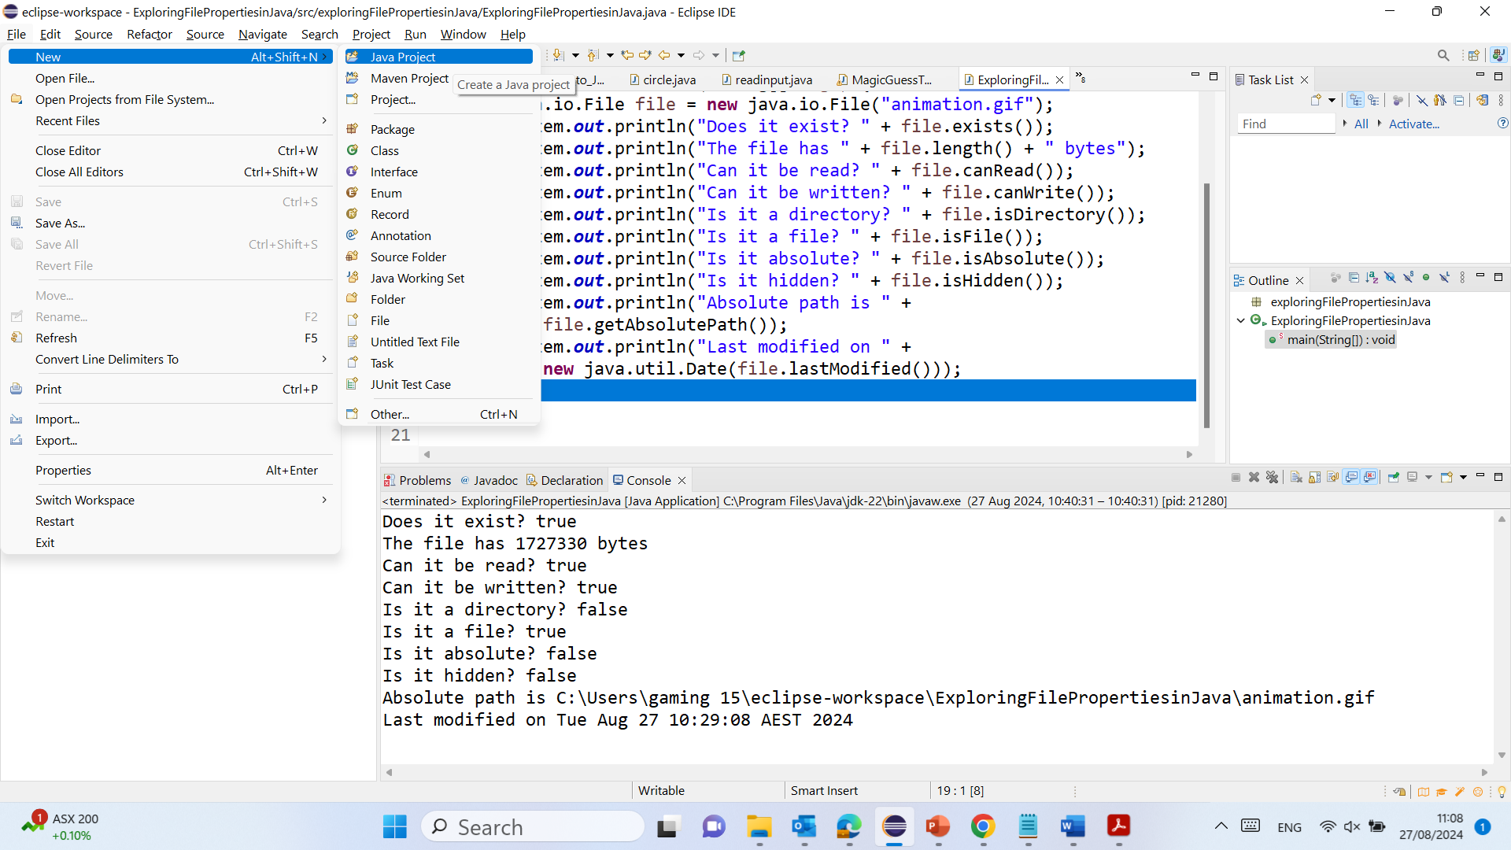
Writing Data Using PrintWriter

Slide 52
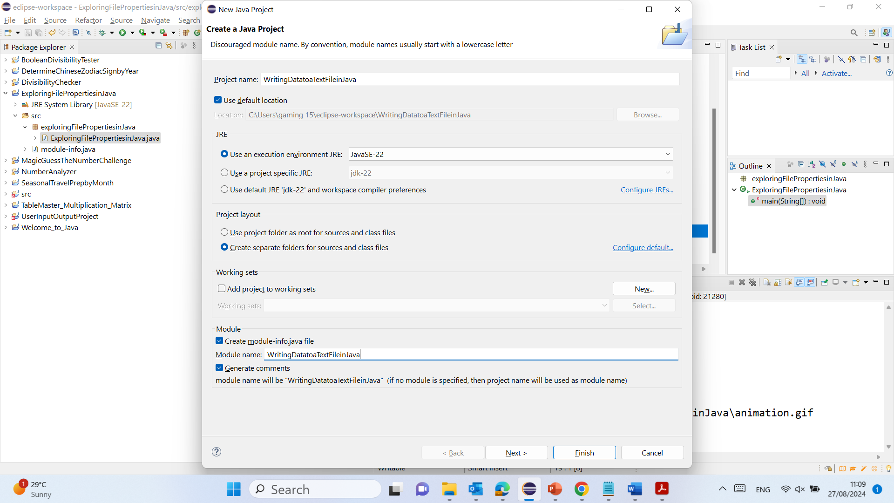
Writing Data Using PrintWriter

Slide 53
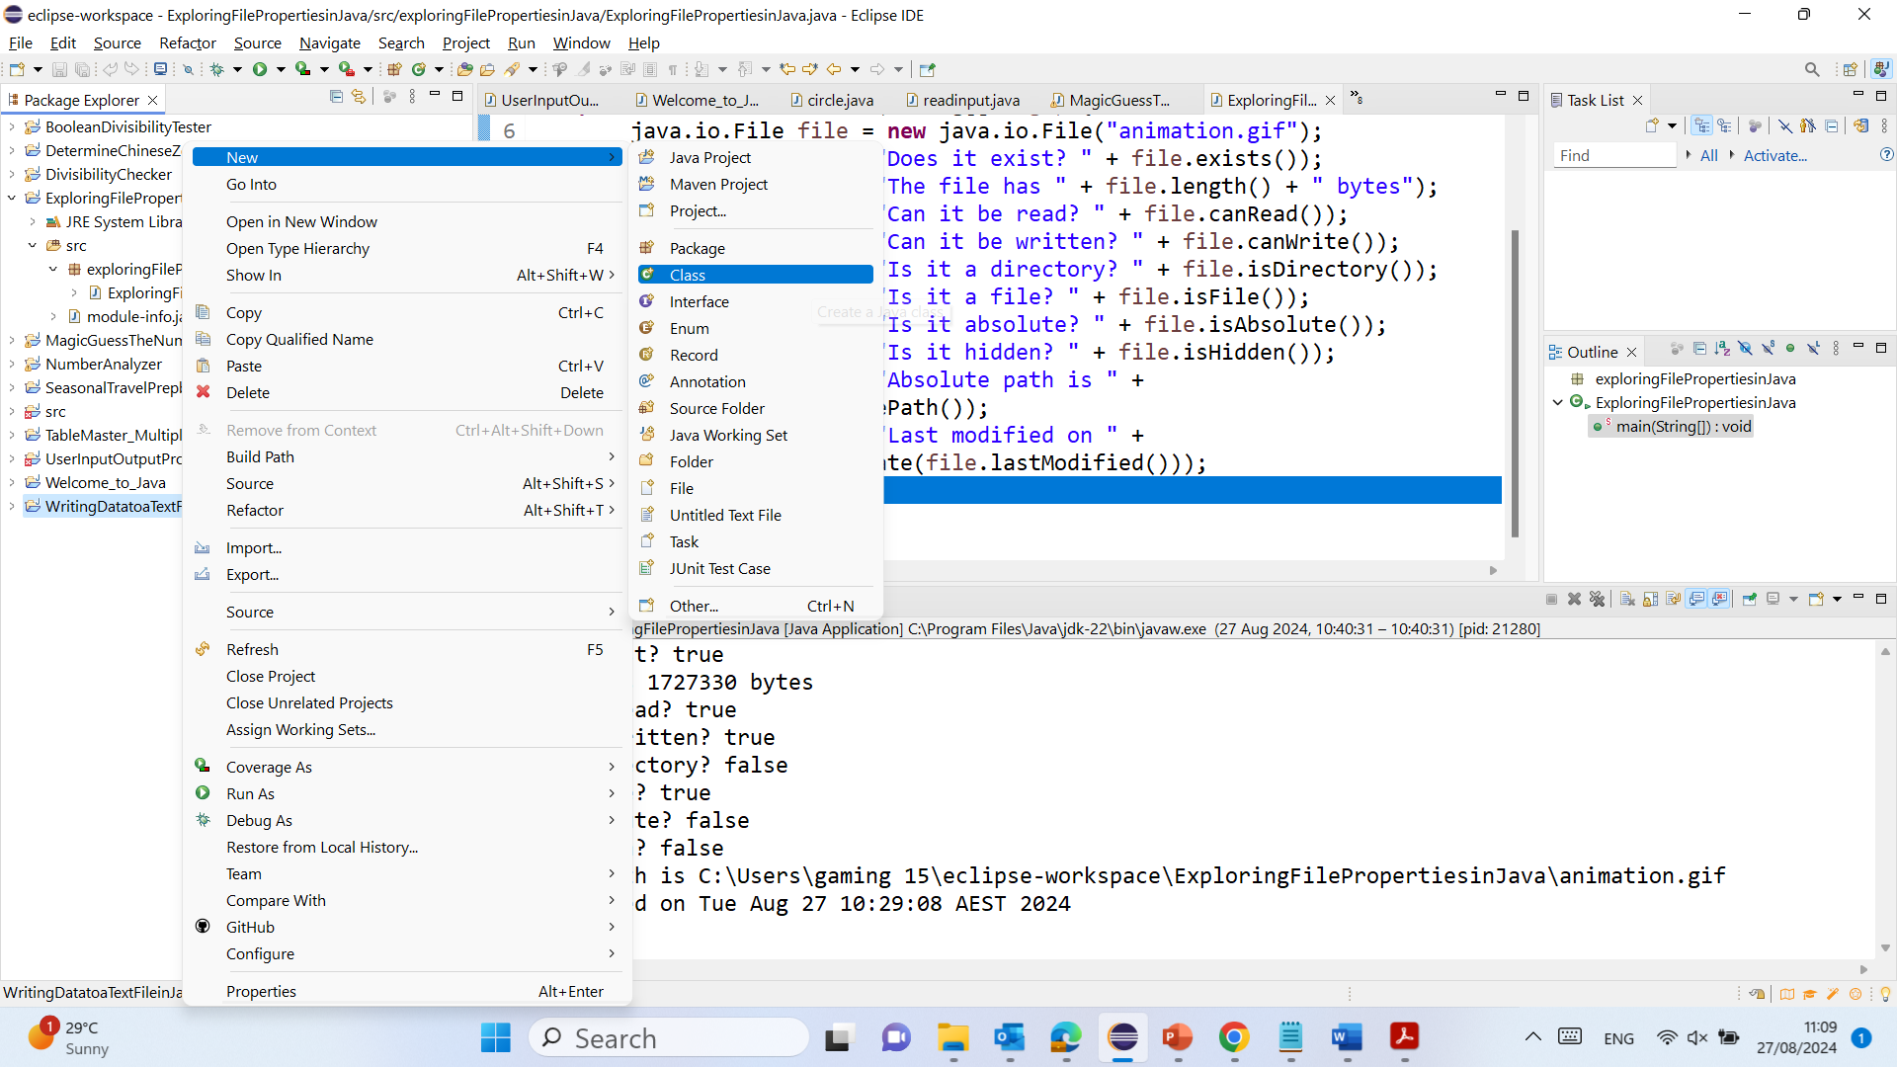
Writing Data Using PrintWriter

Slide 54
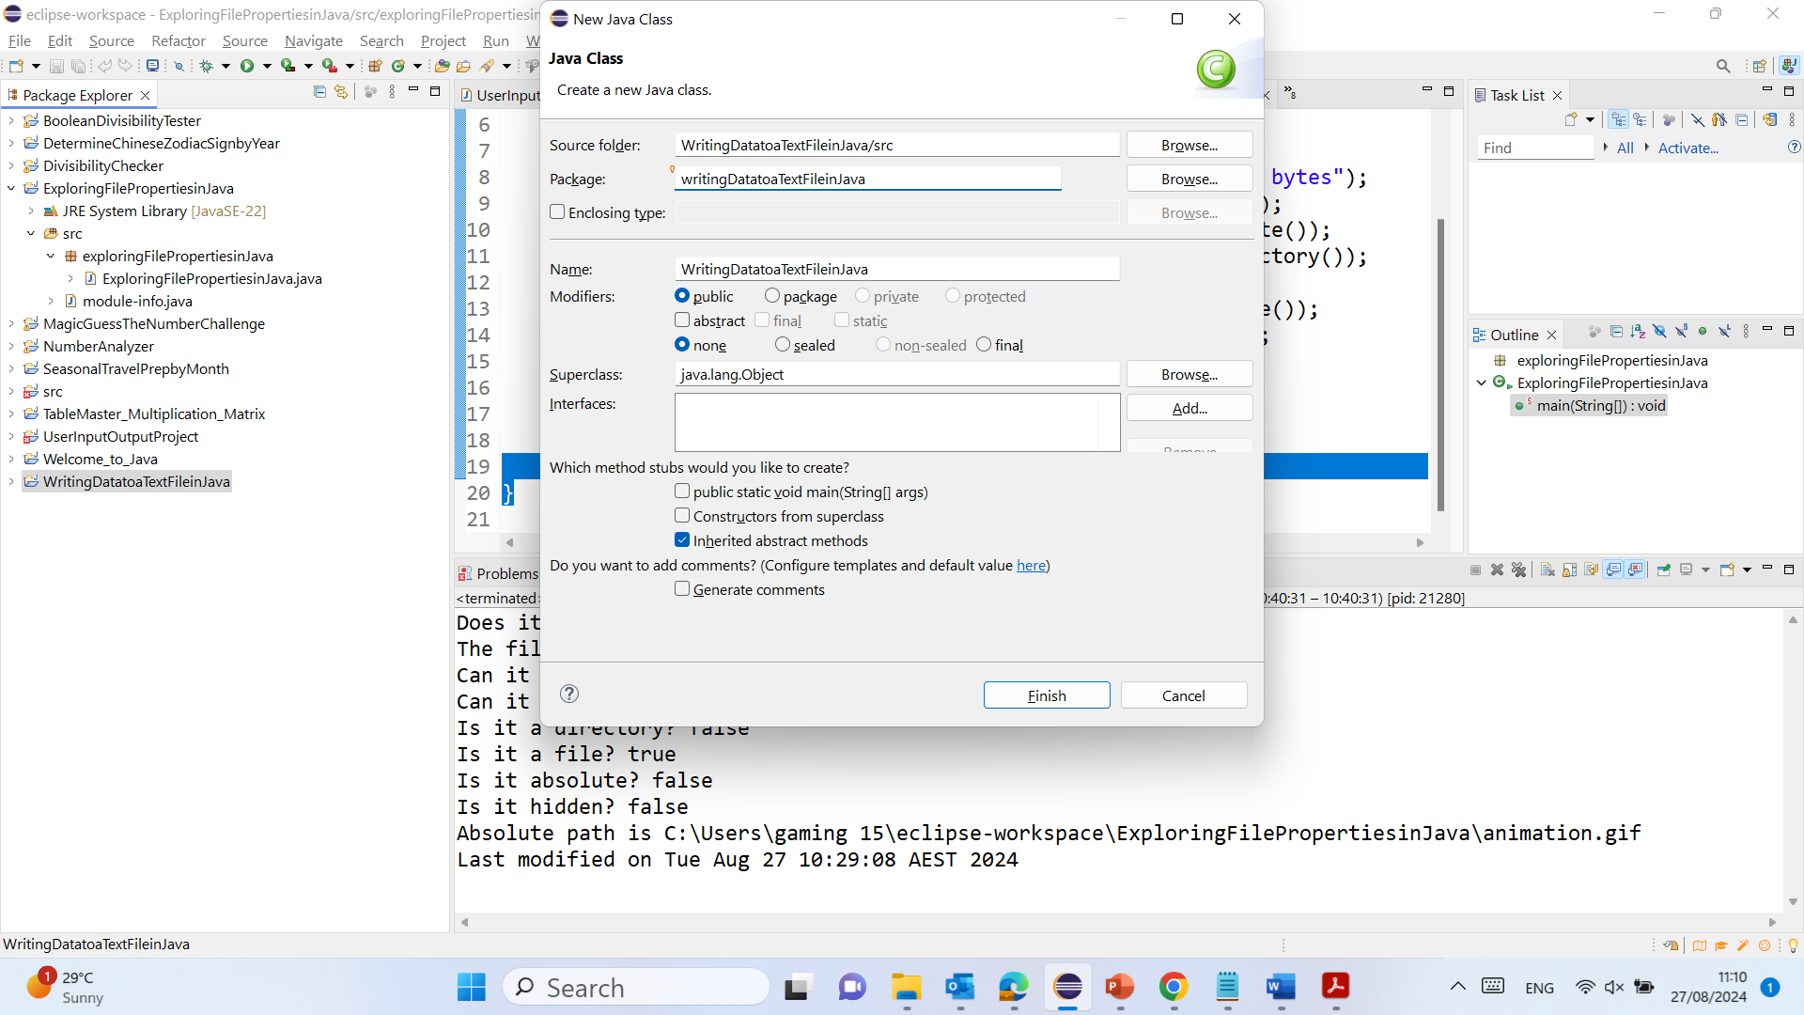
Writing Data Using PrintWriter

Slide 55
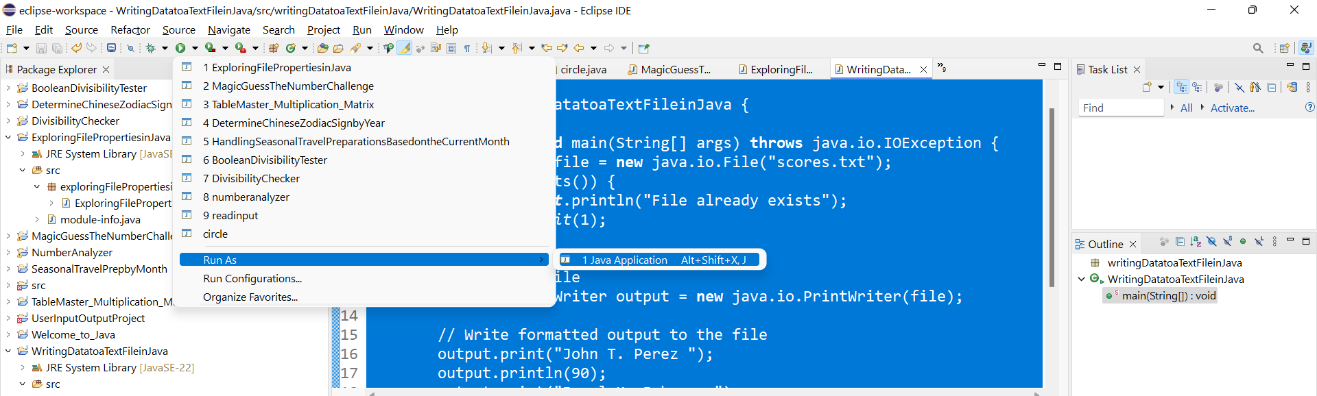
Writing Data Using PrintWriter

Slide 56
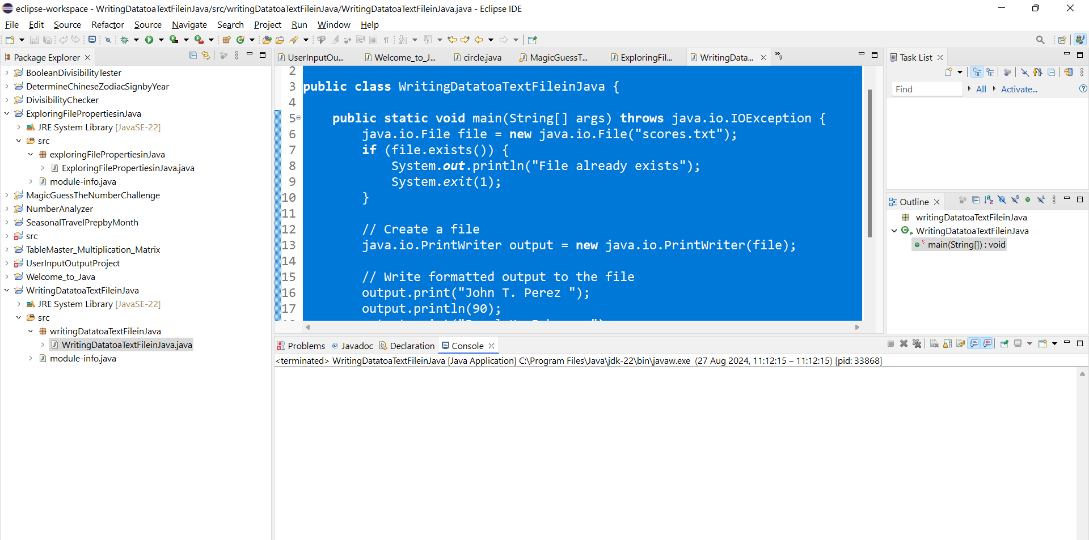
Writing Data Using PrintWriter

Slide 57
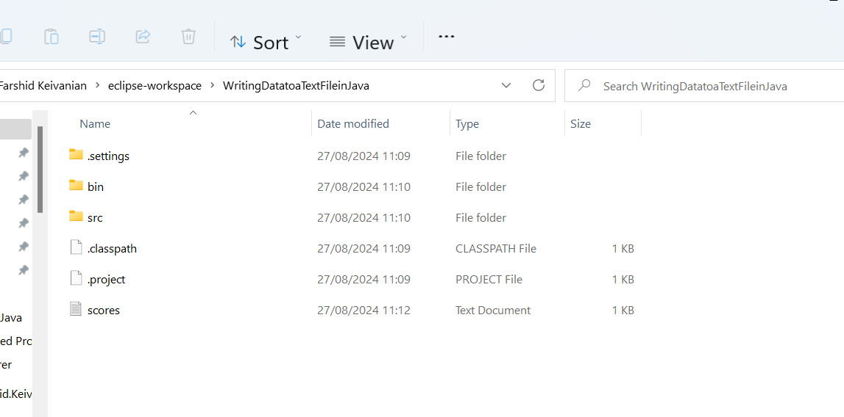
Writing Data Using PrintWriter

Slide 58
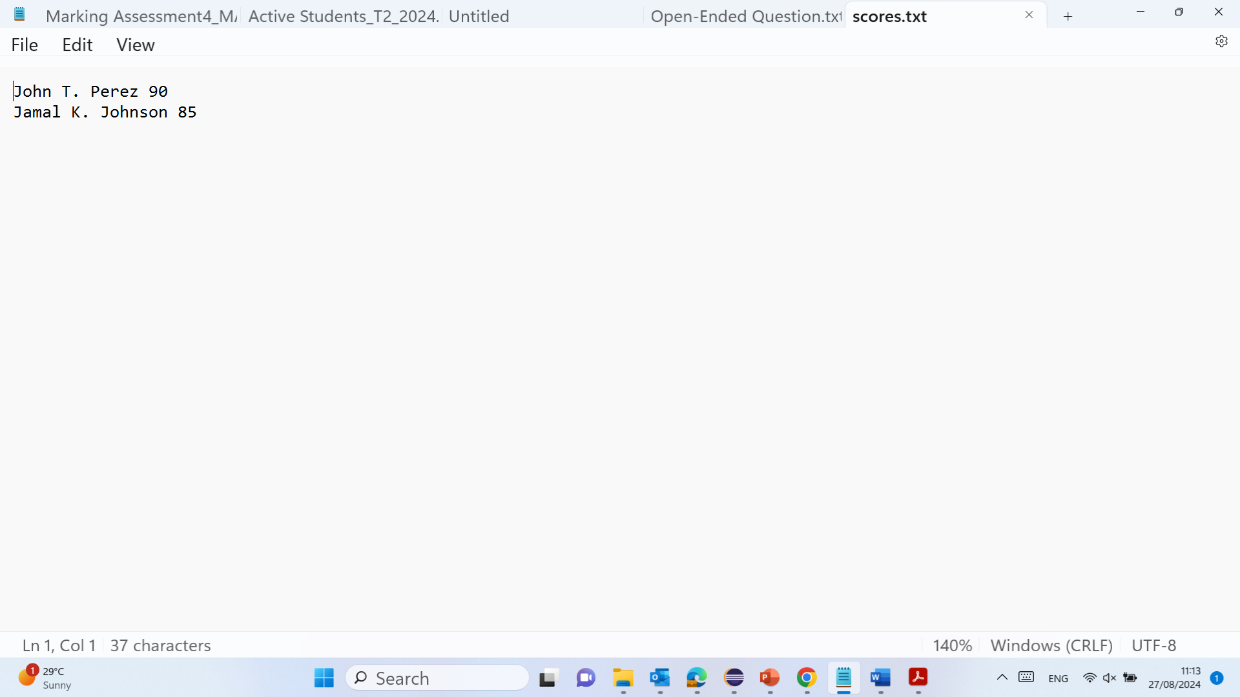
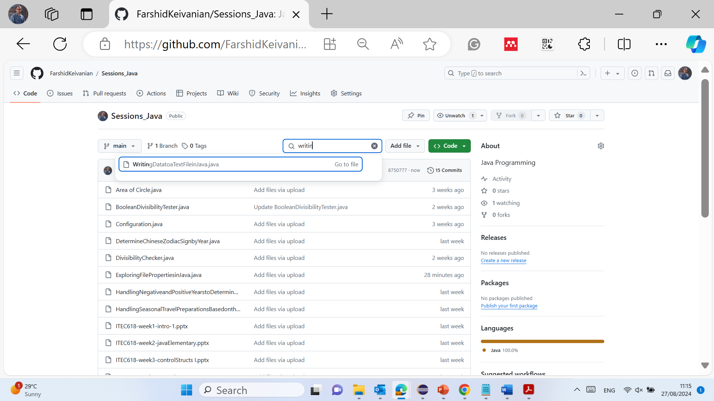
Writing Data Using PrintWriter

Slide 59
Writing Data Using PrintWriter
package writingDatatoaTextFileinJava;
public class WritingDatatoaTextFileinJava {
1. package writingDatatoaTextFileinJava;
Explanation: This line declares the package in which this class resides. A package is a way to group related classes and interfaces together to avoid name conflicts and to manage files more efficiently in large projects. The package name here is writingDatatoaTextFileinJava, which indicates that the code is related to writing data to a text file in Java.
2. public class WritingDatatoaTextFileinJava {
Explanation: This line declares a public class named WritingDatatoaTextFileinJava. A class in Java is a blueprint from which objects are created, and it contains fields and methods to define its behavior. The public keyword means that this class can be accessed by any other class.

Slide 60
Writing Data Using PrintWriter
public static void main(String[] args) throws java.io.IOException {
3. public static void main(String[] args) throws java.io.IOException {
Explanation: This line defines the main method, which is the entry point of any Java application. When you run a Java program, the main method is the first method that is executed.
public: The method is accessible from anywhere.
static: The method belongs to the class rather than an instance of the class, so it can be called without creating an object of the class.
void: The method does not return any value.
String[] args: This is an array of strings that can store command-line arguments passed to the program.
throws java.io.IOException: This clause indicates that the method might throw an IOException, which is a checked exception that needs to be either caught or declared in the method signature. This exception is related to input/output operations, such as file handling.

Slide 61
Writing Data Using PrintWriter
java.io.File file = new java.io.File("scores.txt");
4. java.io.File file = new java.io.File("scores.txt");
Explanation: This line creates a new File object representing a file named scores.txt. The java.io.File class provides an abstract representation of file and directory pathnames. The file path provided is relative, meaning it is relative to the current working directory of the application.

Slide 62
Writing Data Using PrintWriter
if (file.exists()) {
System.out.println("File already exists");
System.exit(1);
}
5. if (file.exists()) {
Explanation: This line checks if the file scores.txt already exists in the directory. The exists() method of the File class returns true if the file or directory denoted by this abstract pathname exists, and false otherwise.
6. System.out.println("File already exists");
Explanation: If the file scores.txt already exists, this line prints a message to the console indicating that the file exists. This serves as a warning that the file will not be created again.
7. System.exit(1);
Explanation: This line terminates the program with a status code of 1, which typically indicates an abnormal termination. In this case, it is used to prevent overwriting the existing file.

Slide 63
Writing Data Using PrintWriter
// Create a file
java.io.PrintWriter output = new java.io.PrintWriter(file);
8. java.io.PrintWriter output = new java.io.PrintWriter(file);
Explanation: This line creates a PrintWriter object associated with the file. The PrintWriter class is used to write formatted text to a file. If the file does not exist, it will be created; if it does exist, it will be overwritten unless the existence check is performed, as in this code.

Slide 64
Writing Data Using PrintWriter
// Write formatted output to the file
output.print("John T. Perez ");
output.println(90);
output.print("Jamal K. Johnson ");
output.println(85);
9. output.print("John T. Perez ");
Explanation: This line writes the string "John T. Perez " to the file. The print() method of PrintWriter writes the string to the file without adding a newline character.
10. output.println(90);
Explanation: This line writes the integer 90 to the file and then adds a newline character. The println() method of PrintWriter writes the value and then moves the cursor to the next line, which is useful for formatting the output.
11. output.print("Jamal K. Johnson ");
Explanation: Similar to the previous print() statement, this line writes the string "Jamal K. Johnson " to the file without adding a newline character.
12. output.println(85);
Explanation: This line writes the integer 85 to the file and then adds a newline character. Like before, println() is used to format the output by moving to the next line after writing.

Slide 65
Writing Data Using PrintWriter
// Close the file
output.close();
}
}
13. output.close();
Explanation: This line closes the PrintWriter object, which is an important step in file handling. Closing the writer ensures that all data is flushed to the file and that the file is properly closed, freeing up system resources. Failing to close a writer can lead to data corruption or loss.
14. }
Explanation: This closing curly brace marks the end of the main method.
15. }
Explanation: This closing curly brace marks the end of the WritingDatatoaTextFileinJava class.

Slide 66
Writing Data Using PrintWriter
Summary:
This program demonstrates how to create and write formatted data to a text file in Java. It first checks if the file scores.txt already exists to avoid overwriting it. If the file does not exist, it is created, and the program writes two formatted records (names and scores) to the file. Finally, it closes the file to ensure that all data is saved correctly and that system resources are freed.

Slide 67
Try-with-resources
Programmers often forget to close the file. JDK 7 provides the followings new try-with-resources syntax that automatically closes the files.
try (declare and create resources) {
Use the resource to process the file;
}
WriteDataWithAutoClose

Slide 68
Try-with-resources
Introduction:
In Java, managing resources like file streams can be tricky because if you forget to close a file after using it, you might end up with resource leaks, which can lead to memory issues and file corruption. To address this, Java 7 introduced the try-with-resources statement, which automatically closes resources once they are no longer needed. This feature makes your code more reliable and easier to maintain, as it ensures that all resources are properly closed without the need for explicit close() calls in your code.

Slide 69
Try-with-resources
Key Terms:
Try-with-Resources: A try statement that declares one or more resources. A resource is an object that must be closed after the program is finished with it, such as file streams. The try-with-resources statement ensures that each resource is closed at the end of the statement.
Resource Leak: Occurs when a program does not release resources properly, such as failing to close a file, which can lead to memory leaks and other issues.

Slide 70
Reading Data Using Scanner
ReadData

Slide 71
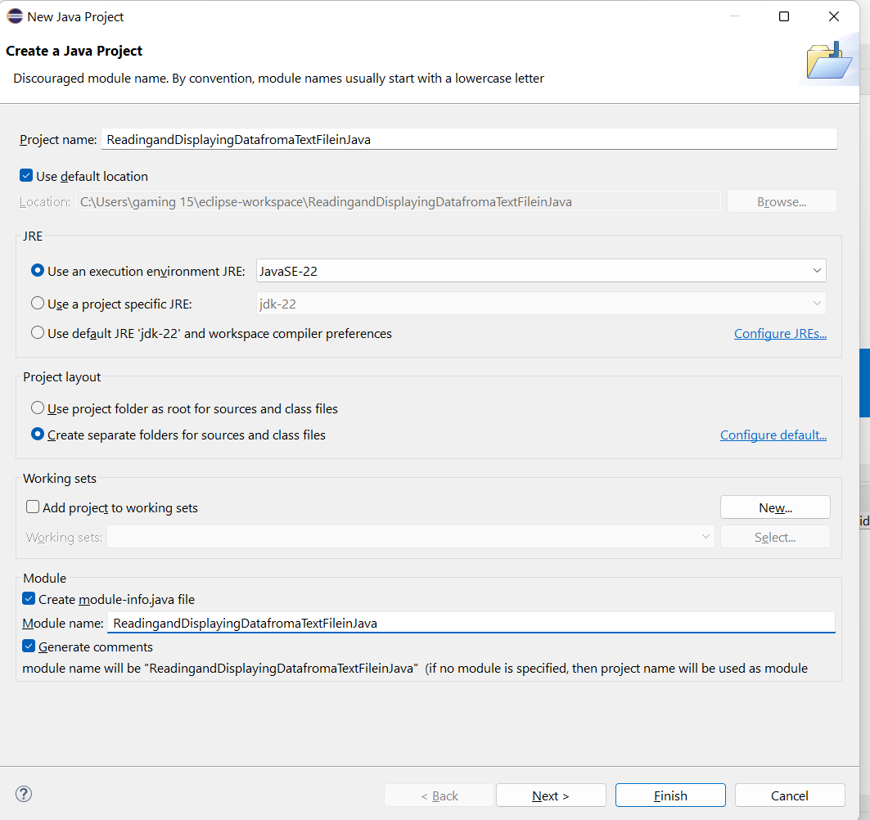
Reading Data Using Scanner

Slide 72
Reading Data Using Scanner

Slide 73
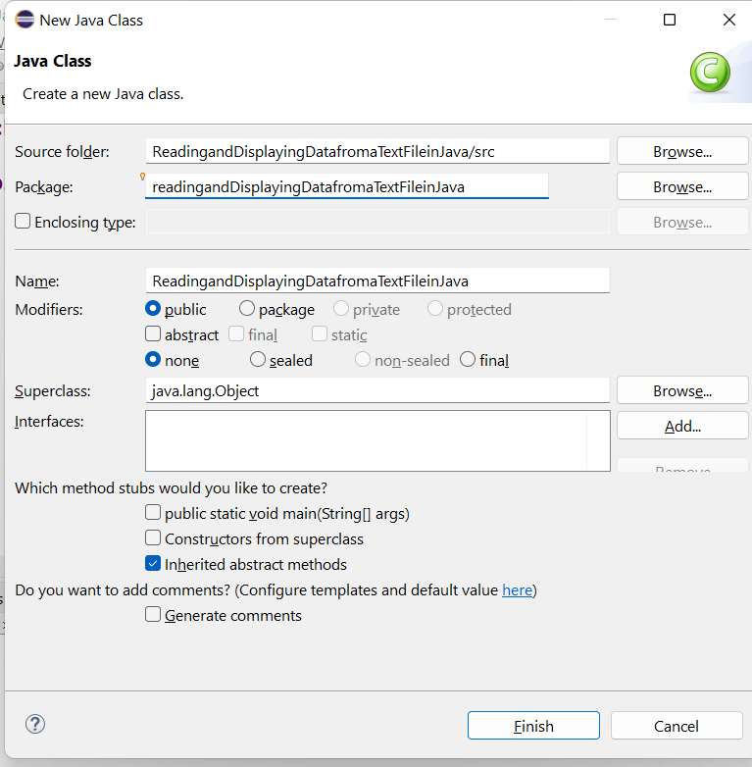
Reading Data Using Scanner

Slide 74
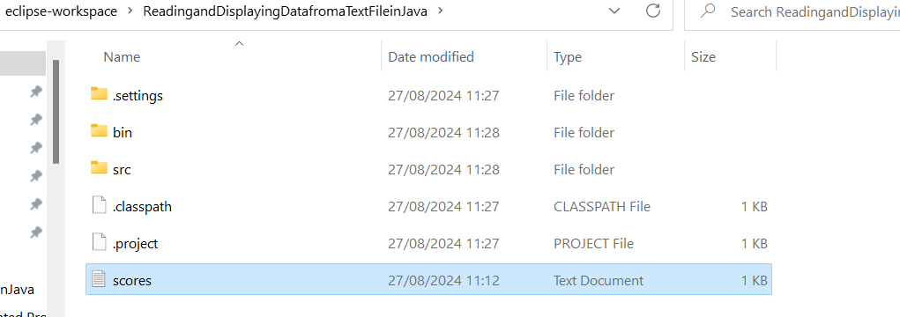
Reading Data Using Scanner

Slide 75
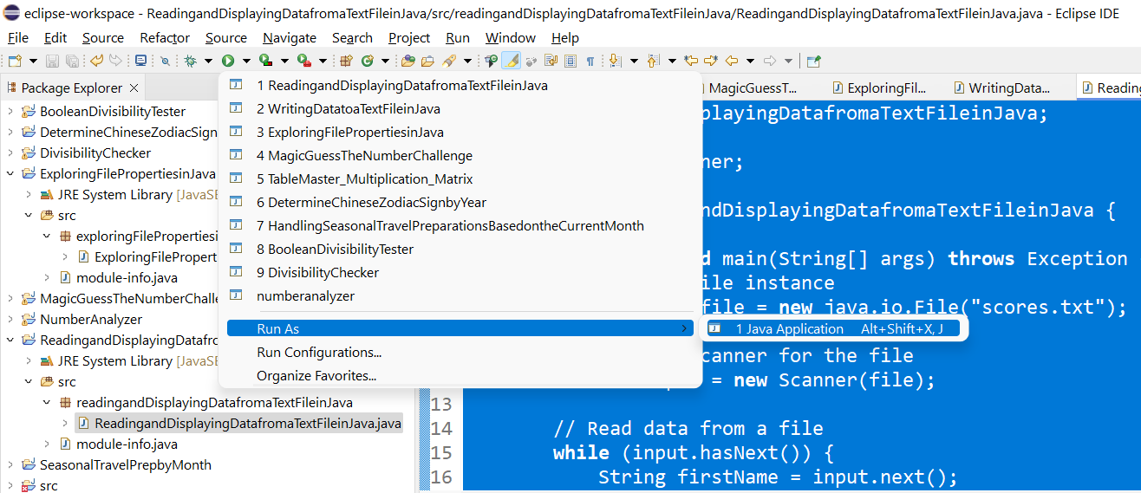
Reading Data Using Scanner

Slide 76
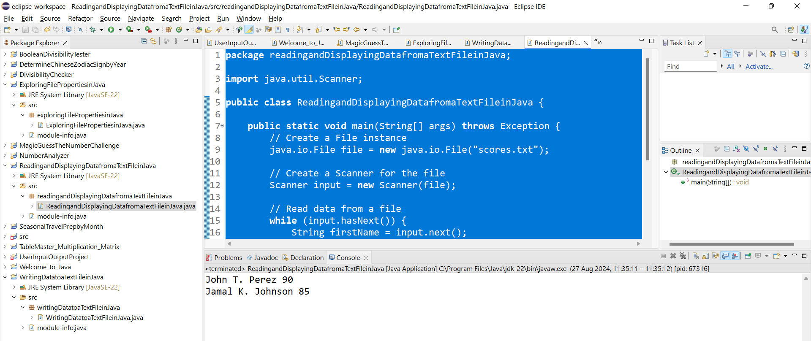
Reading Data Using Scanner

Slide 77
Provide a Power Point Explanation of Each Part and Send it to FaKeivanian@acu.edu.au Calibri Font Size 28
package readingandDisplayingDatafromaTextFileinJava;
import java.util.Scanner;
public class ReadingandDisplayingDatafromaTextFileinJava {
public static void main(String[] args) throws Exception {
// Create a File instance
java.io.File file = new java.io.File("scores.txt");
// Create a Scanner for the file
Scanner input = new Scanner(file);
// Read data from a file
while (input.hasNext()) {
String firstName = input.next();
String mi = input.next();
String lastName = input.next();
int score = input.nextInt();
System.out.println(
firstName + " " + mi + " " + lastName + " " + score);
}
// Close the file
input.close();
}
}

Slide 78
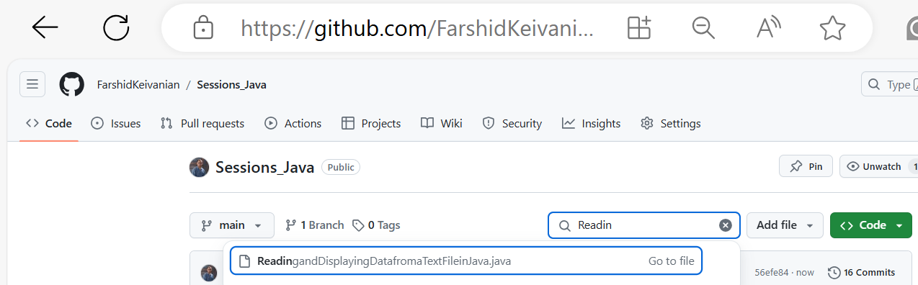
Provide a Power Point Explanation of Each Part and Send it to FaKeivanian@acu.edu.au Calibri Font Size 28

Slide 79
Command-line arguments
public class CommandLine {
public static void main(String args[]){
for(int i=0; i<args.length; i++){
System.out.println("args[" + i + "]: " + args[i]);
}
}
}
java CommandLine this is a command line 200 -100
args[0]: this
args[1]: is
args[2]: a
args[3]: command
args[4]: line
args[5]: 200
args[6]: -100
Also in LEO Week 5 Material

Slide 80
Problem: Replacing Text
Write a class named ReplaceText that replaces a string in a text file with a new string. The filename and strings are passed as command-line arguments as follows:
java ReplaceText sourceFile targetFile oldString newString
For example, invoking
java ReplaceText FormatString.java t.txt StringBuilder StringBuffer
replaces all the occurrences of StringBuilder by StringBuffer in FormatString.java and saves the new file in t.txt.
ReplaceText

Slide 81
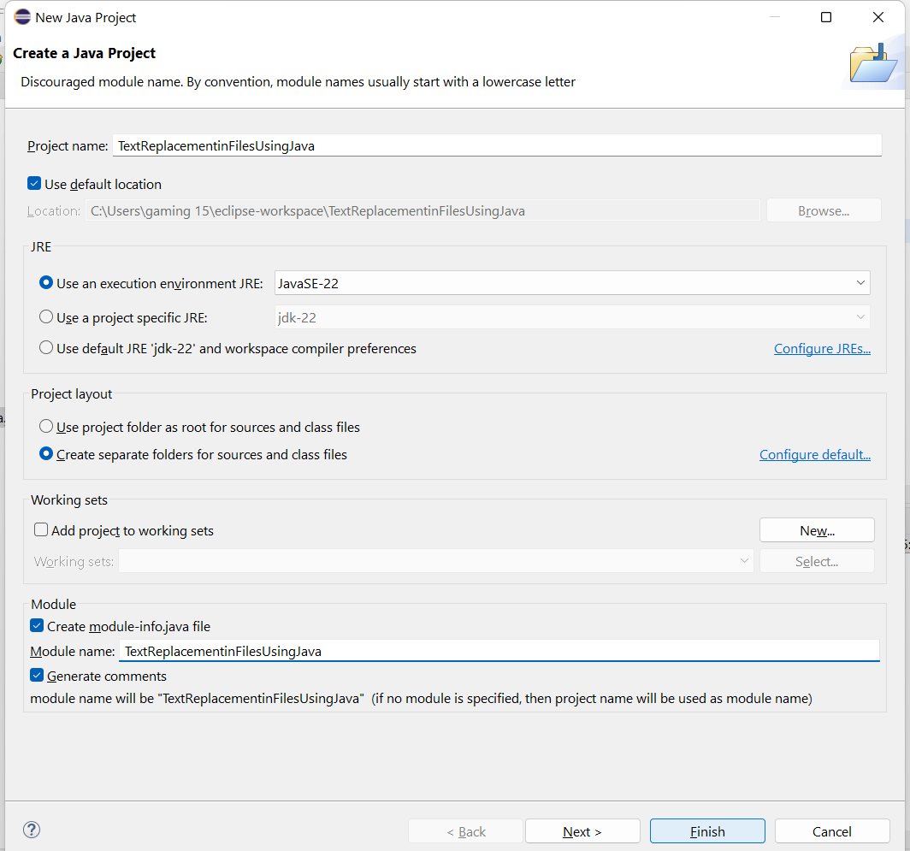
Problem: Replacing Text

Slide 82
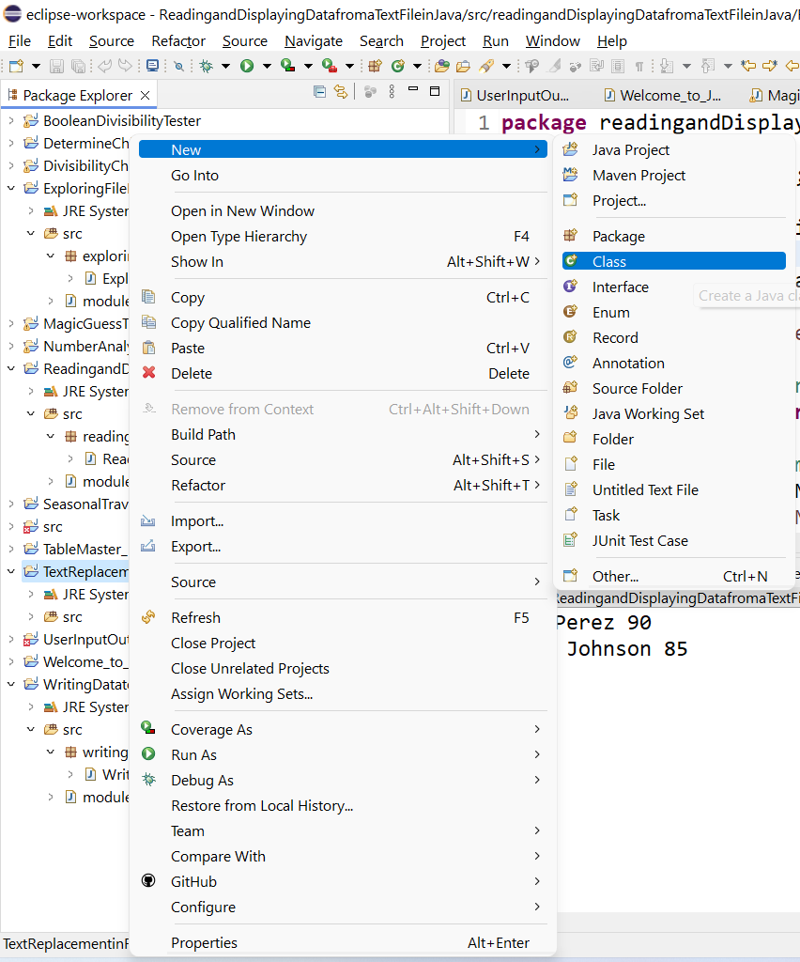
Problem: Replacing Text

Slide 83
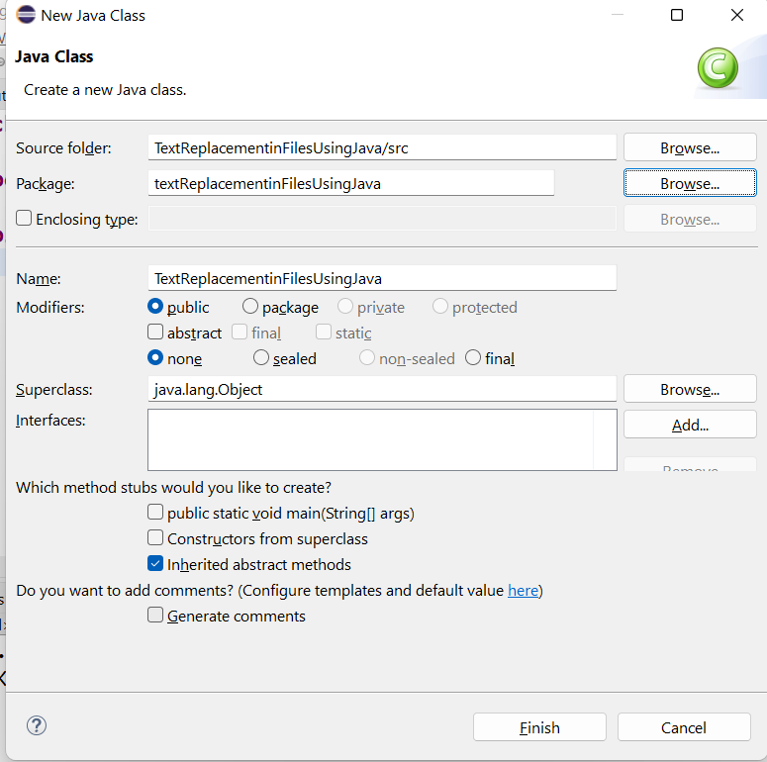
Problem: Replacing Text

Slide 84
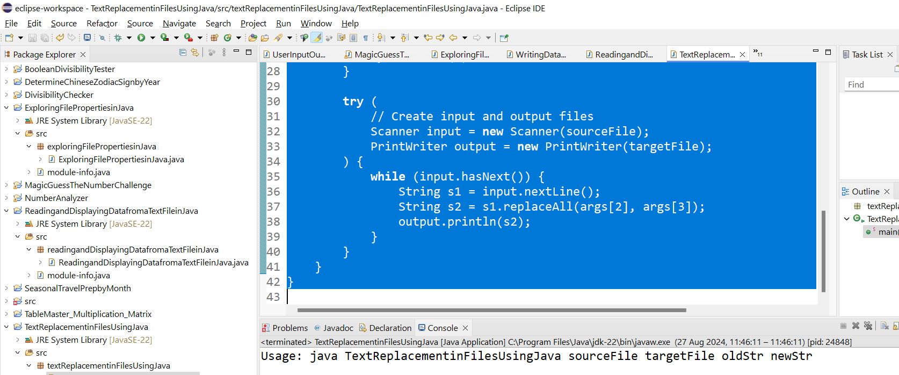
Provide a Power Point Explanation of Each Part and Send it to FaKeivanian@acu.edu.au Calibri Font Size 28
Problem: Replacing Text

Slide 85

Problem: Replacing Text
Provide a Power Point Explanation of Each Part and Send it to FaKeivanian@acu.edu.au Calibri Font Size 28

